Slide 1



Data Analysis of Daily Market Yard Prices in Telangana
Presented by:
K. Sadhana
Ch. Siri Chandana
G. Vidhathri
K. Deekshitha
Under the guidance of:
Mr. Mallikarjun Appani

Slide 2
Introduction:
Tracking daily prices in Telangana’s market yards helps farmers, traders, and consumers understand price trends, plan better, and make informed decisions.
The main objective of the project is
Identify Price Trends: To find patterns in daily price changes.
Seasonal Variations: To understand how prices fluctuate during different seasons.
Market Comparisons: To compare prices across different market yards for better insights.

Slide 3
Dataset Description
Data Source:
We have collected this dataset from OPEN DATA TELANGANA website.
It includes daily prices collected over a specific period (from 2023 September to 2024 August)
Data Fields:
CommName
Arrivals
Minimum, maximum price
Yard name
DateTime and many more

Slide 4
Procedure:
Import “Daily market yard prices in Telangana“ Dataset to power-bi desktop
Transforming data:
Rename column name – “CommName” to “Products”
– “DDate” to “DateTime”
Filtered Products Column
Load Data to Power-Bi desktop
Created Report pages.

Slide 5
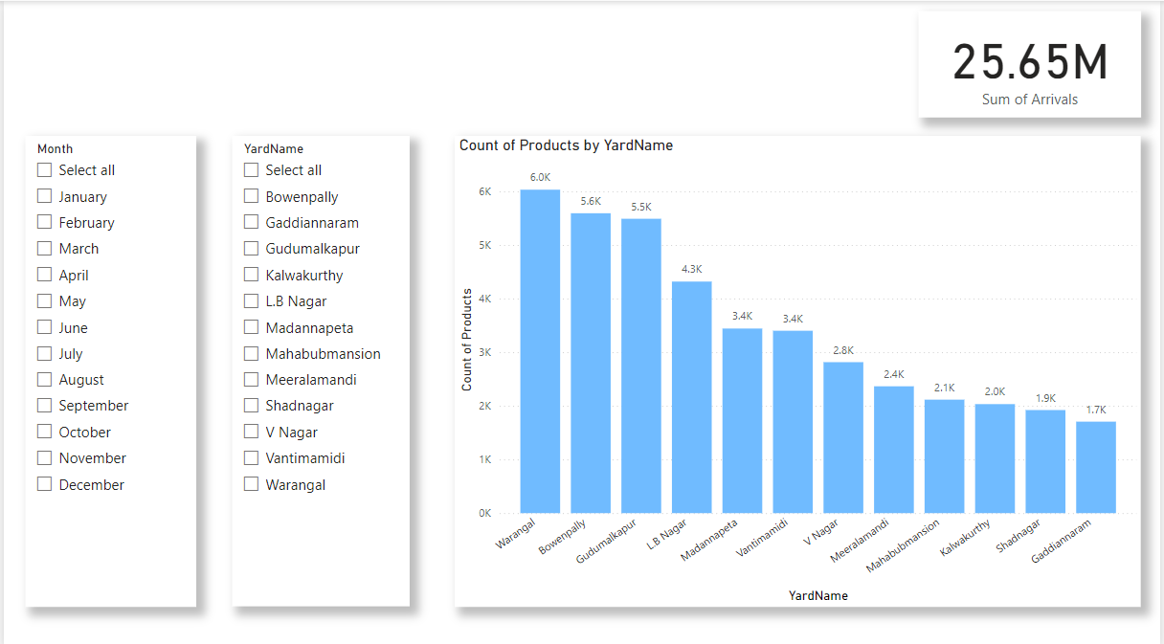
Overview page:
The chart displays the count of products across different market yards in Telangana.
Key Highlights:
Highest product count – Warangal
Lowest product counts - Shadnagar and Gaddiannaram .
Total Sum of Arrivals - 25.65M.

Slide 6
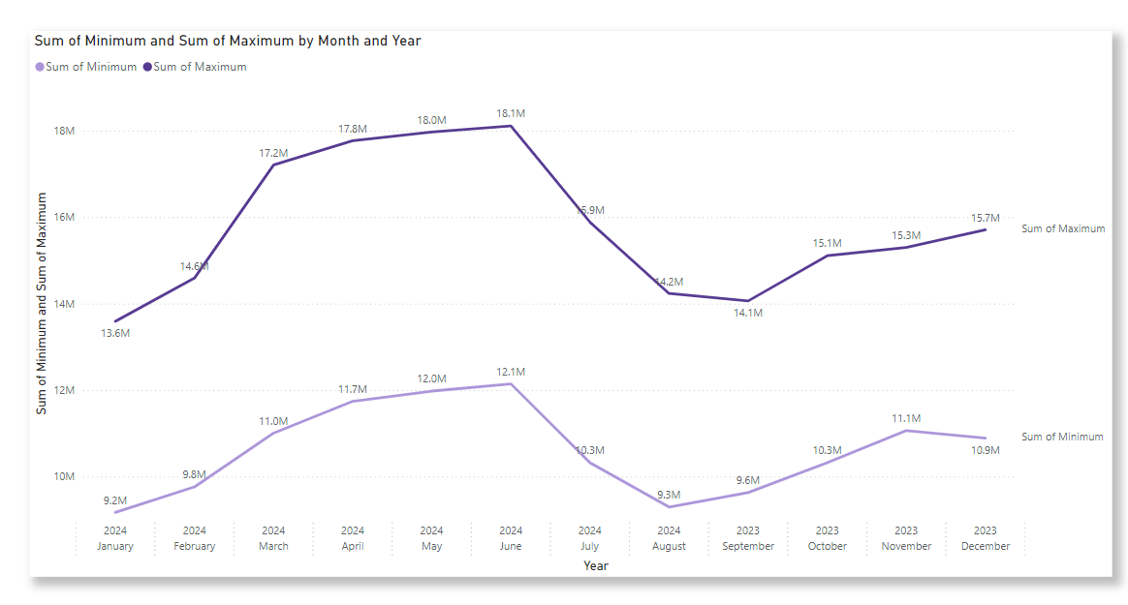
Price Trend Analysis:
Right Chart: Sum of Minimum and Maximum Prices by Month and Year
Sum of Maximum Prices Reached a peak at June 2024
Sum of Minimum Prices gradually dropped by August 2024

Slide 7
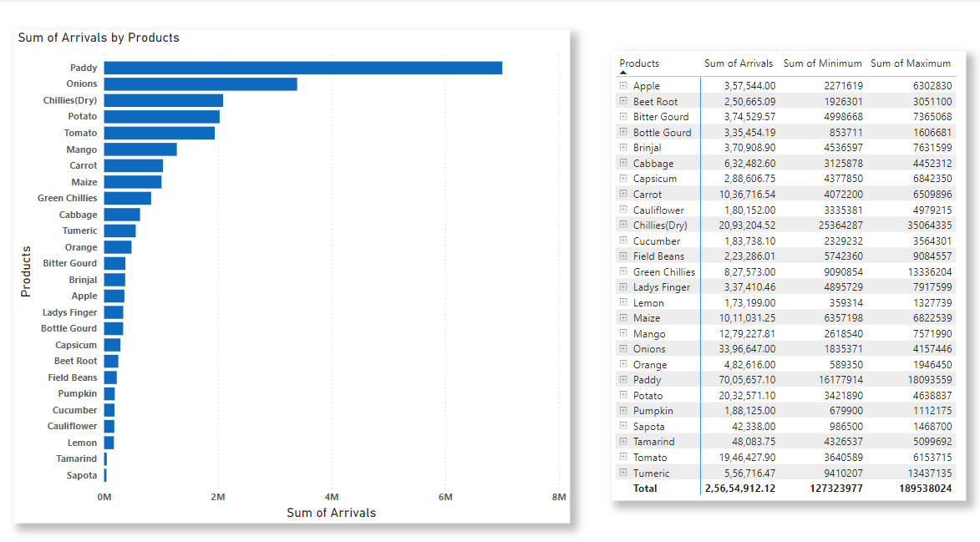
Product performance:
Left Chart: Sum of Arrivals by Products
Highest arrivals - Paddy (7.0M)
Lowest arrivals - Turmeric, Orange, Pumpkin, Lemon, and Sapota (0.02M).
Right Table: Sum of Arrivals, Minimum, and Maximum by Products
Top-arrived product – Paddy
Higher price product - Chillies (Dry)

Slide 8
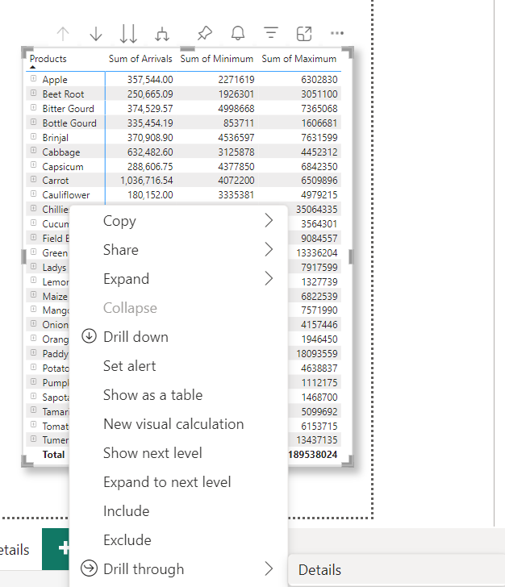
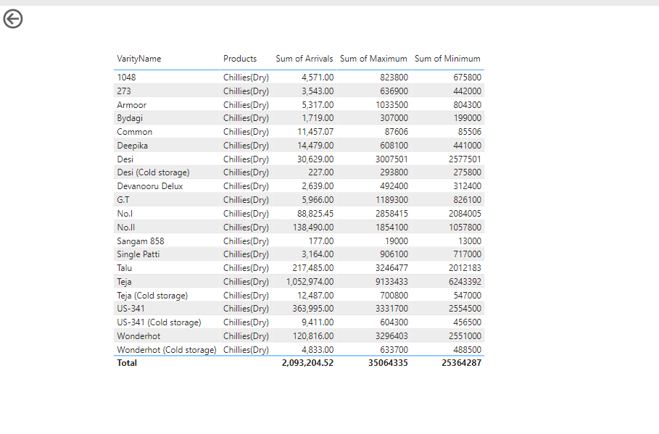
Details page
By clicking on item in the product column, it shifts to details page which contains specified details of the product that includes VarietyName , Products, SumOfArrivals , Maximum and minimum prices.

Slide 9
Conclusion:
Overall the project involved analyzing market yard prices and product arrivals in Telangana state using Power BI.
Through various visualizations, we gained valuable insights into product trends, pricing patterns, and market performance over time.
The insights derived from this analysis can help in strategic decision-making for farmers, traders in agriculture.

Slide 10
Thank you!

